Slide 1
COLLEGE BOT USING AI
Team Members
1.Anand S [711714104005]
2.Arul Kumar T [711714104011]
3.Divya U [711714104018]
4.Mohamed Sharuk CM [711714104033]
Guided by
Industry Mentor: Mr.Vasanth
Faculty Mentor: Ms. Poongothai. K
Department of CSE, KGiSL Institute of Technology, Coimbatore

Slide 2
Abstract
The College bot is built using artificial intelligence that analyses user’s queries and understand user’s message. Students and parents just have to query through the bot by chatting. Students can chat using text format. The System uses built in artificial intelligence to answer the query. The system provides answers as per user queries. The System analyses the question and then answers to the user. The user can query about admissions and its details.
Department of CSE, KGiSL Institute of Technology, Coimbatore

Slide 3
Area Introduction-Existing system
Chatbot is a computer program designed to simulate conversations with humans. The first chatbot, Eliza, was built in 1966 at the MIT Artificial Intelligence Laboratory by Joseph Weizenbaum to mimic human conversations. There are various chatbots already available such as Poncho (Messenger bot), Insomno bot (Chatting), Melody and Dr.AI. (Healthcare), Natasha (Messenger and chatting).
Department of CSE, KGiSL Institute of Technology, Coimbatore

Slide 4
Proposed System
College Bot using AI and machine learning which provides information about the college to the users.
Advantages over existing methods:
The College Bot gives detailed information about the college.
Future enhancement:
We will develop an open domain for every college in the city.
Department of CSE, KGiSL Institute of Technology, Coimbatore

Slide 5
Literature Review
Drawbacks of existing methods:
Lack of detailed information
Lack of the unavailability of NLP(Natural Language Processing)
References
IEEE
Elbot
Chatbot Magazines
Department of CSE, KGiSL Institute of Technology, Coimbatore

Slide 6
Data Flow Diagram Level 0
User
Chat Bot Application
Admin
Ask query
Update
Response
Department of CSE, KGiSL Institute of Technology, Coimbatore

Slide 7

Data Flow Diagram-Level 1
User
Ask query
Process Query
Search keywords
Response
Query Output
Data store
Admin
Update Logs
Store updates

Slide 8
Module Splitup
Module 1 (Mohamed Sharuk CM)
-Tensor flow integration with python
-Framing Database Structure
Module 2 (Anand S)
-Bot creation using tensor flow
-Creating UI
Module 3 (Arul Kumar T)
-Implement NLP in the bot
-Train the bot
Module 4 (Divya U)
-Deploy the bot
-Handling Information Availability

Slide 9
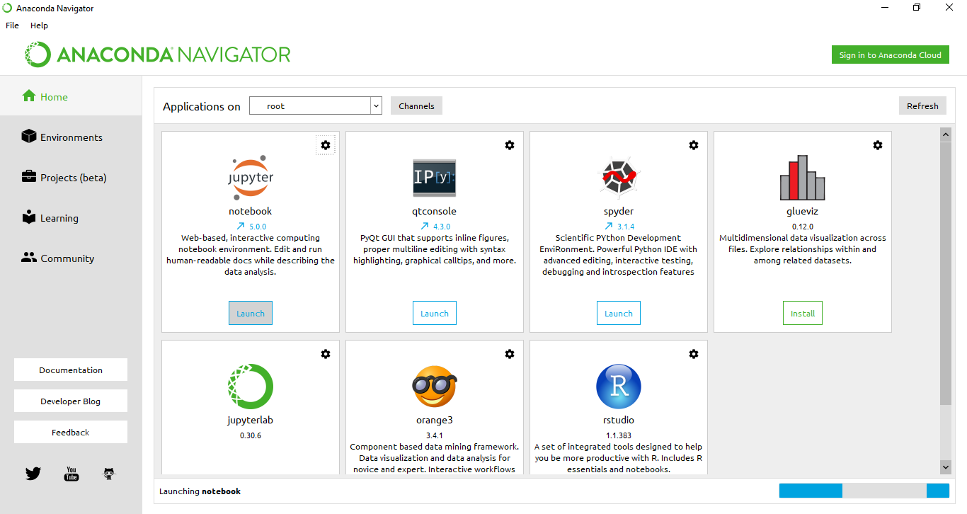
Screen shots of modules

Slide 10
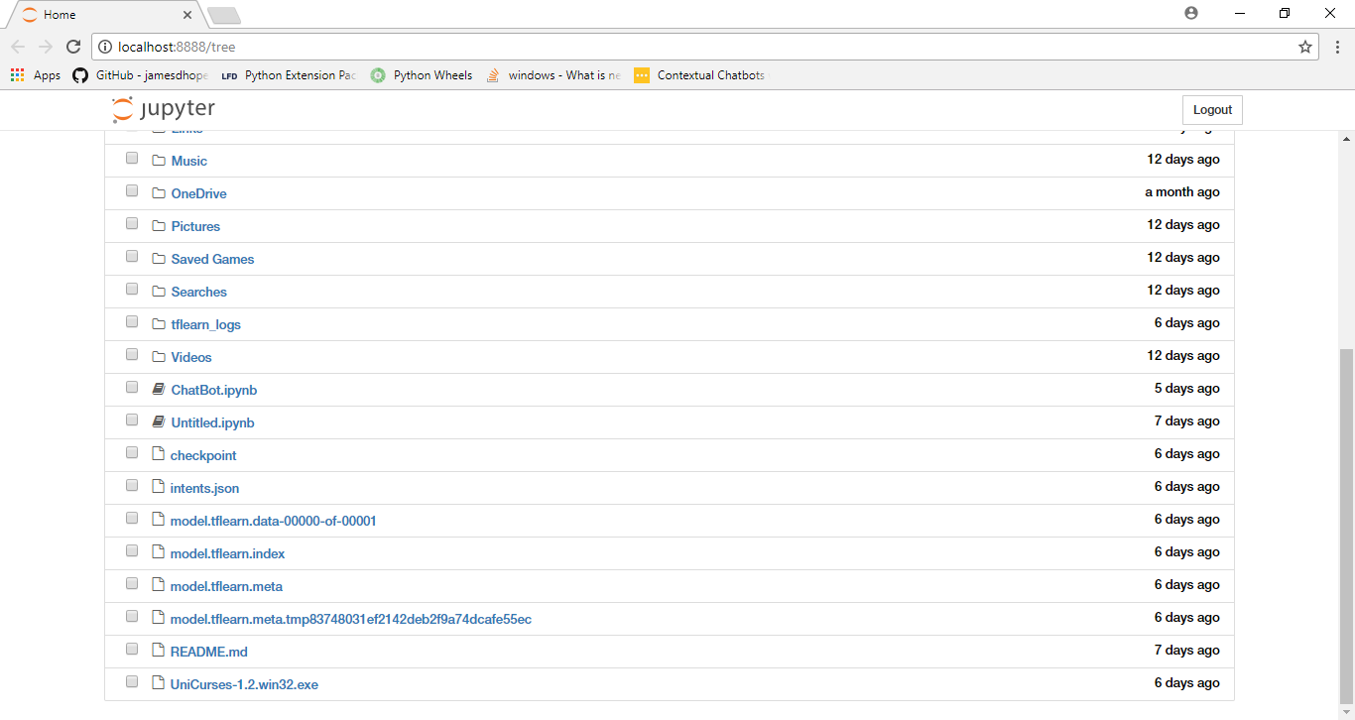
Continued...

Slide 11
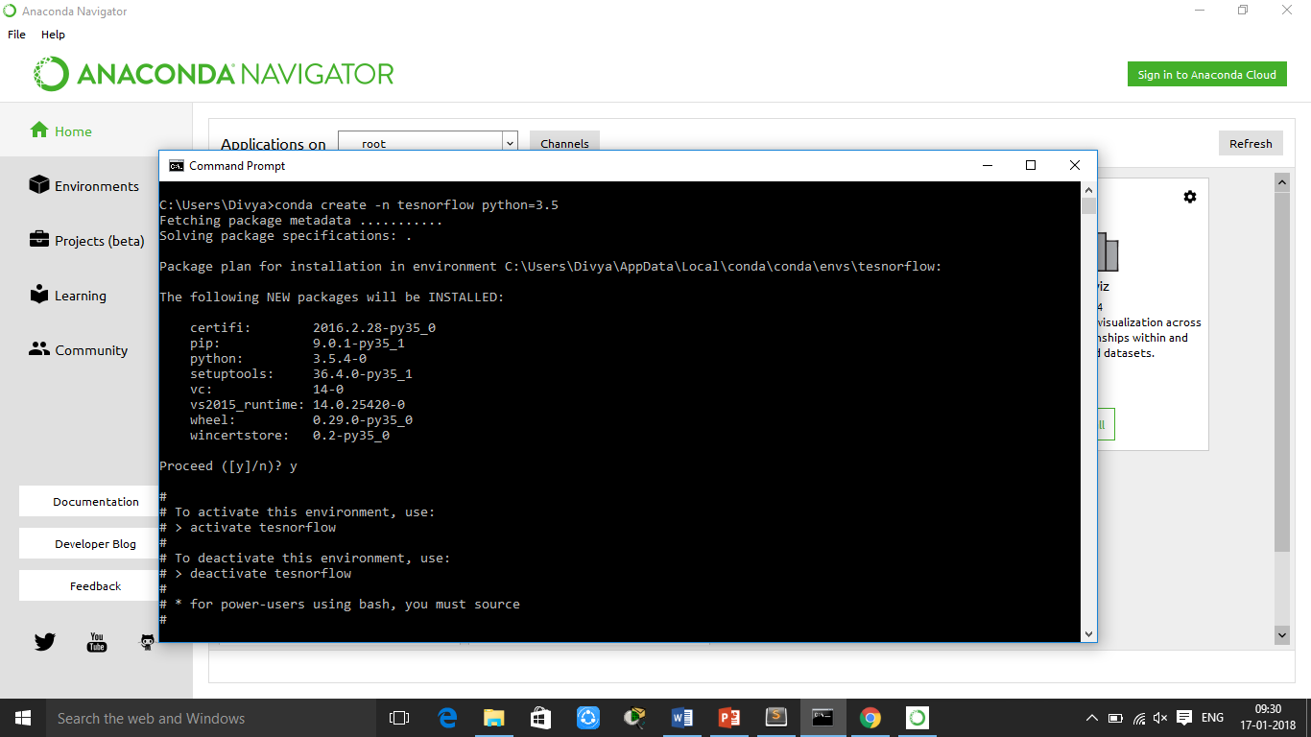
Continued...

Slide 12
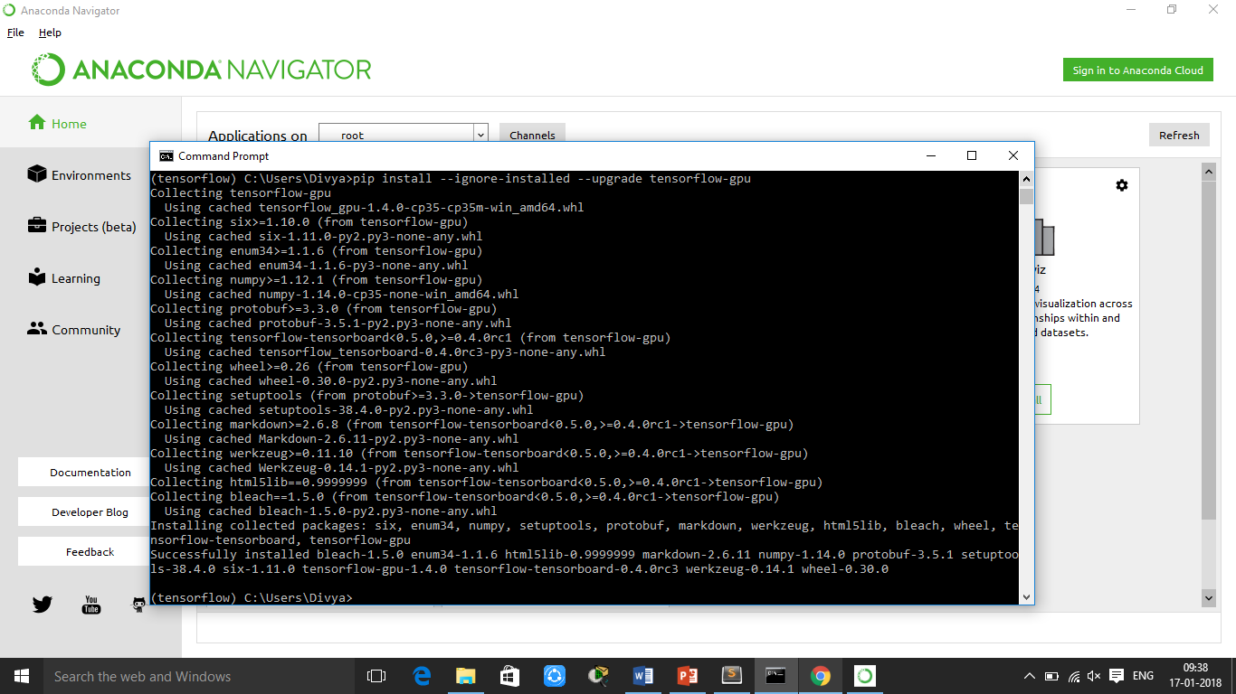
Continued...

Slide 13
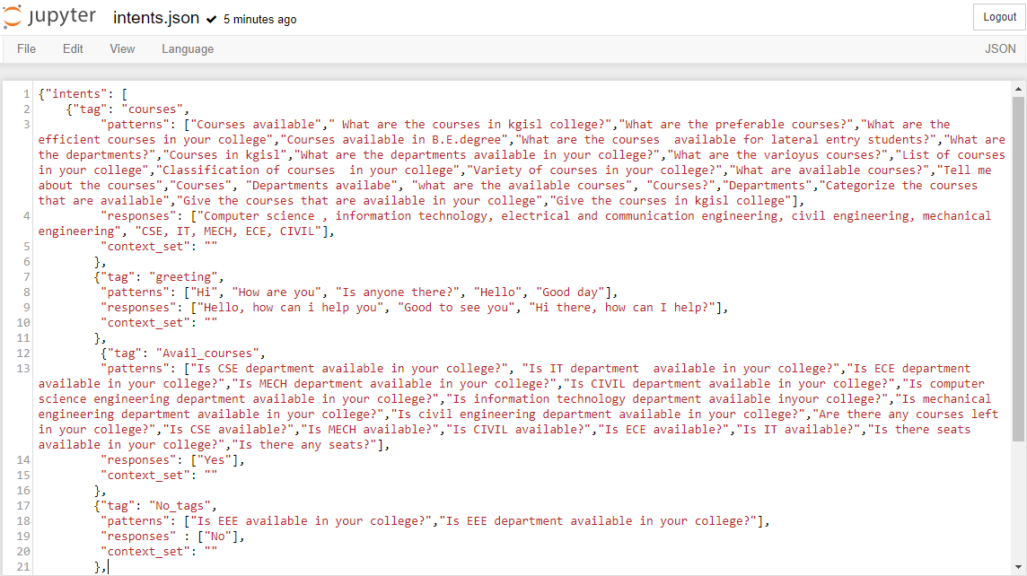
Continued...

Slide 14
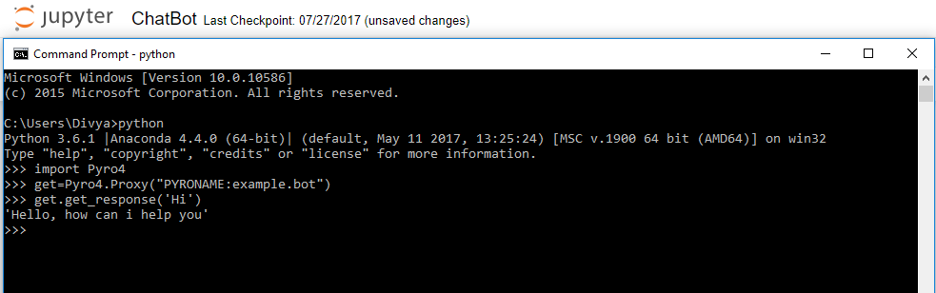
Continued..

Slide 15
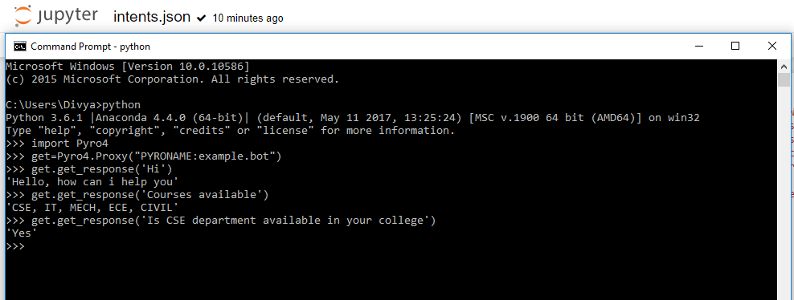
Continued….

Slide 16
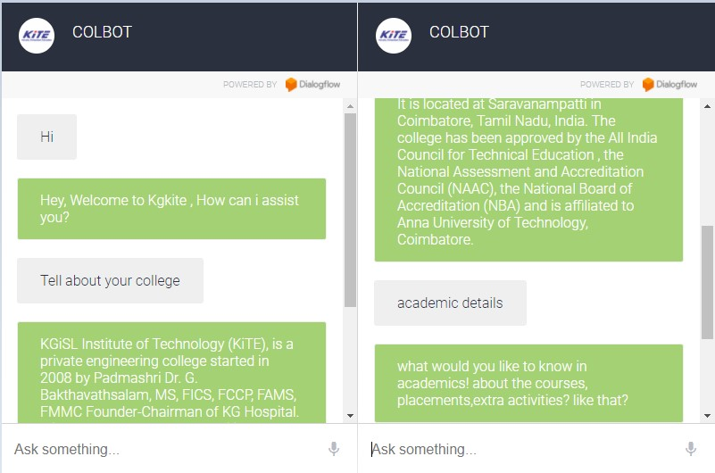
Continued….

Slide 17
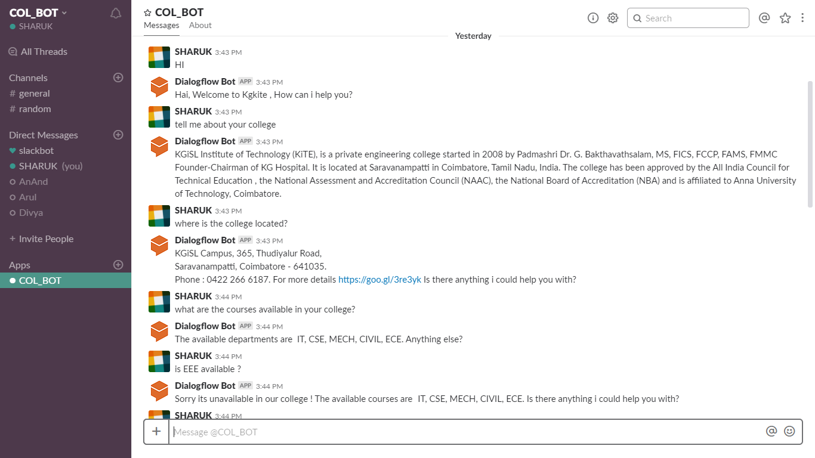
Continued….

Slide 18
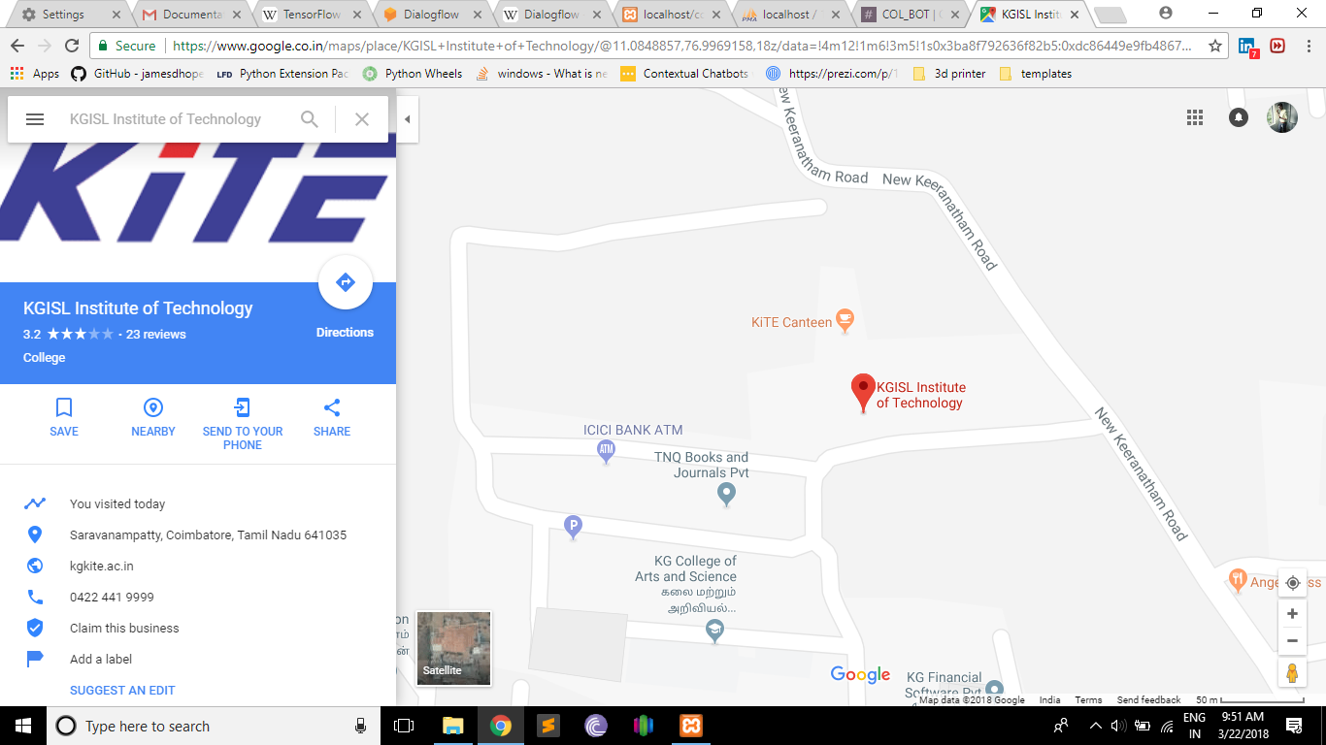
Continued….

Slide 19
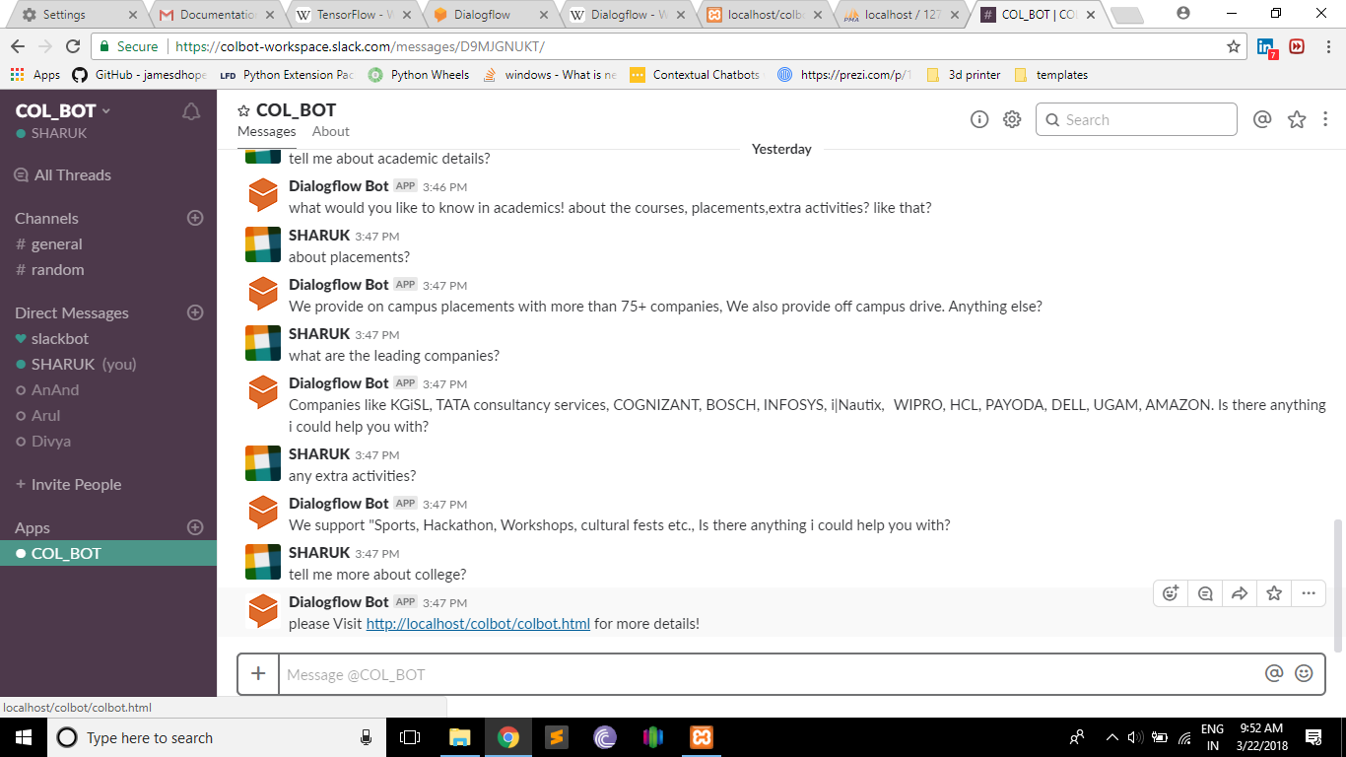
Continued….

Slide 20
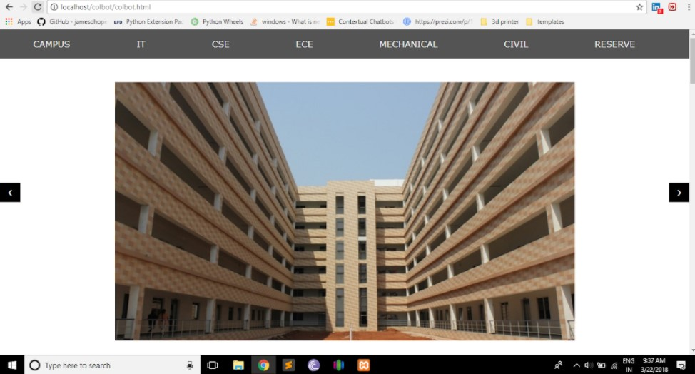
Continued….

Slide 21
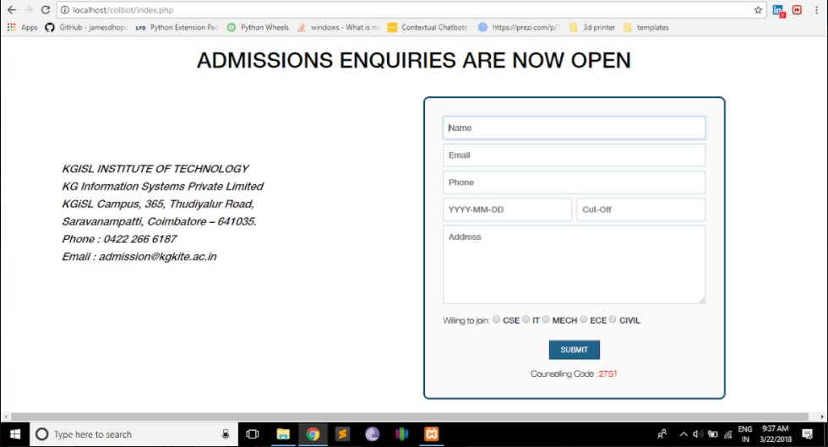
Continued….

Slide 22
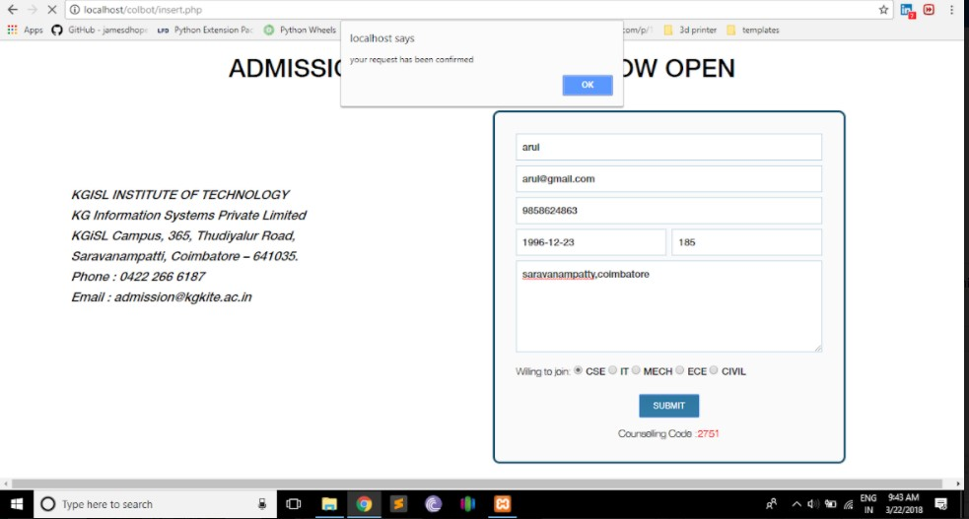
Continued….

Slide 23
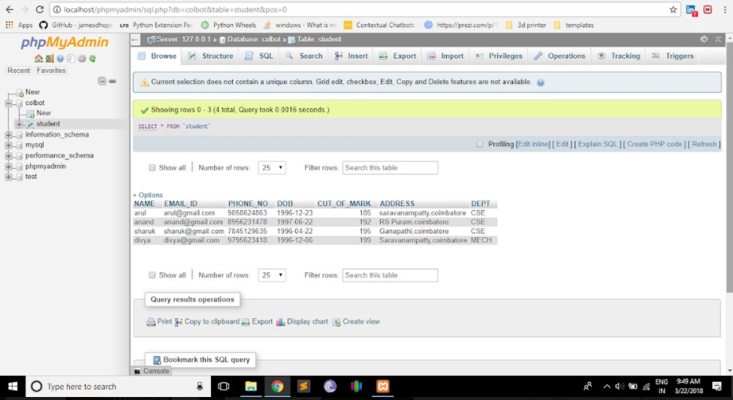
Continued….

Slide 24
Conclusion
A College bot is an automated software program that is designed to enquire information about the college admission. This college bot helps to know the information such as admission details, college infrastructure, academic and non- academic courses available, fees structure, hostel facilities, availability of placements and companies, etc., just by chatting without logging on or browsing to particular websites. With the easy implementation and user-friendly interface, the College bot proves to be the best companion for all the users. It allows the user to chat with the bot. Since most of the users in the world are active in messaging platforms, this college bot will help them to acquire information easier and faster. Thus, College bot can turn out to be one of the best stand-alone application.

Slide 25
Future enhancement
The following are some of the enhancements that can be done to the system in the near future.
Voice recognition
Implementing this system for every college
Fetching details about both technical and non-technical events related to college

Slide 26
Thank You

